Slide 1
Very VBA
Day 4
The Data Boot Camp |
November 13, 2018

Slide 2
Intro to Programming Logic

Slide 3
Ooh… Coding! (Sort Of)
Function
=
SUM(
1, 2, 3
)
Arguments
In a way, Excel has introduced us to a sort of proto-programming. Throughout your time writing scripts you will rely on functions (methods) that do something to or with arguments.

Slide 4
Conditionals: If This… Then That
Set Cell to True
If D2 > 5
Determine D2’s Value
If D2 <=5
Set Cell to False
=IF(D2>5,TRUE,FALSE)

Slide 5
How a Computer Thinks (Procedurally)
Complex Real-World Problem
Every problem in software development begins with a complex and abstract business-need to be solved.

Slide 6
How a Computer Thinks (Procedurally)
Complex Real-World Problem
Step
Step
Step
Step
1
2
3
4
In order for a computer to handle things, this “real-world” problem needs to be broken into a set of procedural steps.

Slide 7
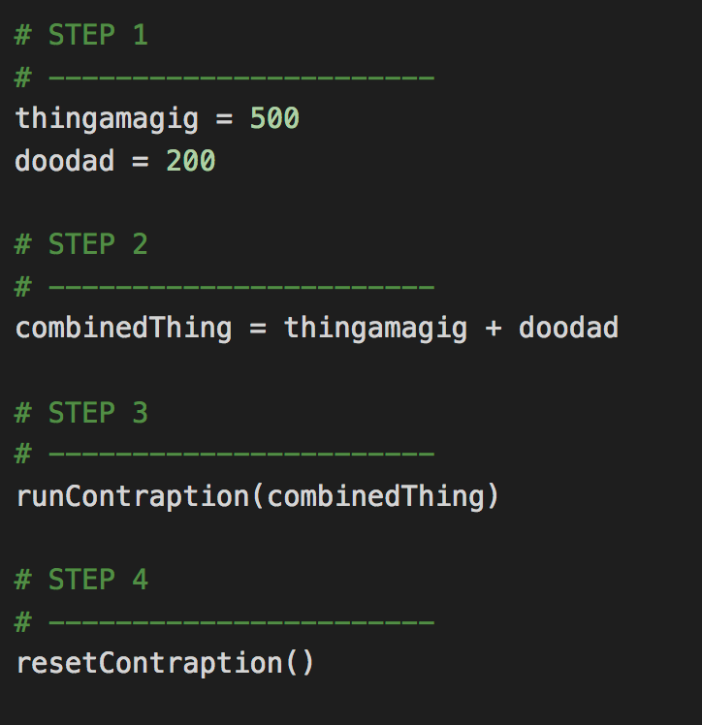
How Code is Written (Procedurally)
Code (Python)
Steps
1
2
3
4

Slide 8
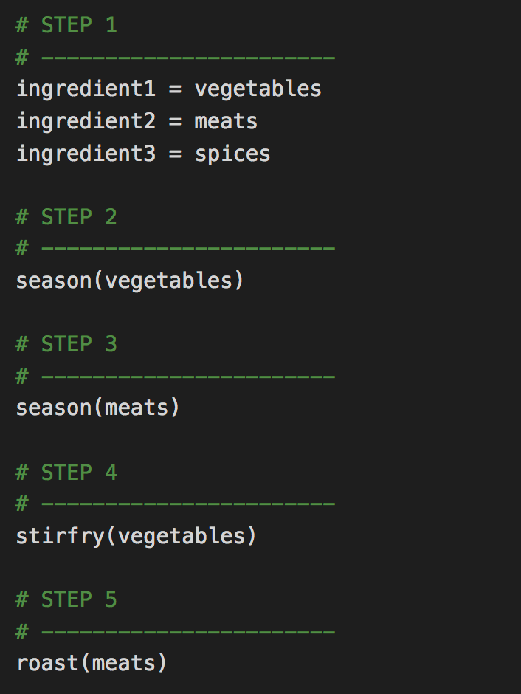
When Procedures Aren’t Enough…
Code (Python)
Steps
1
2
3
4
5

Slide 9
Fundamental Building Blocks
Common structures in nearly all languages:
Variables / Arrays
Conditionals
Iterations
Functions

Slide 10
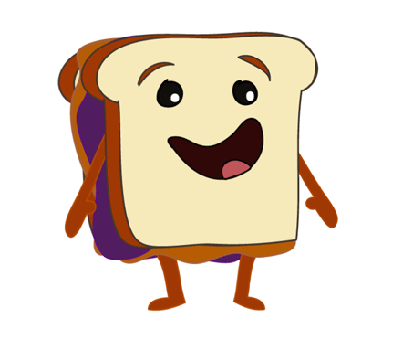
To Make A Sandwich…

Slide 11
To Make a Sandwich…
Logical Procedure
1. Get Bread, Peanut Butter, and Jelly from Pantry
2. Lay out bread on table.
3. Open canisters of Peanut Butter and Jelly.
Oh! I can’t wait to be eaten!
4. Get spreading knife.
5. Use spreading knife to smother peanut butter.
6. Use spreading knife to smother jelly.
7. Combine bread to create sandwich.

Slide 12
VBA Building Blocks

Slide 13
Variables / Arrays

Slide 14
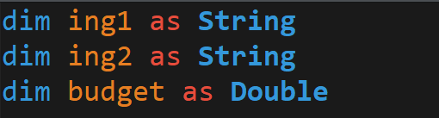
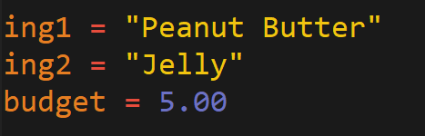
Variables: The Nouns of Code
Variables are effectively the items or names we reserve (declare) to store values that can later be used in our program.
They can be physical things (like an ingredient) or abstractions (like a counter).
In VBA, items can be declared as variables by using the dim followed by the type. They can then be assigned a value.
Variable Declaration
Variable Assignment

Slide 15
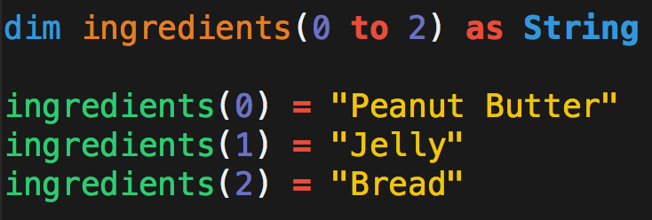
Arrays: A Collection of Items
Arrays are effectively groups of related items. It presents another way to store and reference like pieces of information.
[
Item: 0
Item: 1
Item: 2
[
Peanut Butter
,
Jelly
,
Bread
Excel columns are arrays
Excel rows are arrays.

Slide 16
Conditionals

Slide 17
Conditionals: If This… Then That.
Conditionals present a way to control the flow of logic based on certain conditions being met.
In most languages, we’ll be using if / else code for this purpose.
Step
Step
If Condition a…
2a
1
If Condition b…
2b

Slide 18
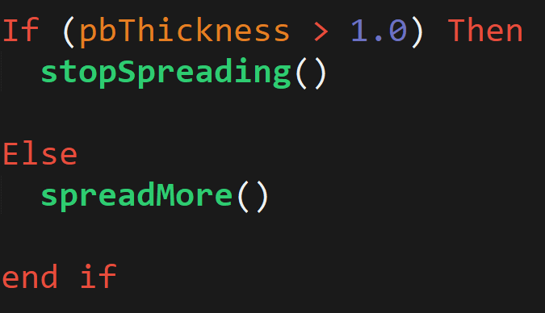
Conditionals: If This… Then That.
In VBA, conditionals are simply declared using the keywords If, Then, Elseif, Else, and End if.
Through VBA we can create far more sophisticated conditional logic than through Excel formulas alone.
Steps
1
2a
2b

Slide 19
Iteration (Looping)

Slide 20
Iteration: Round and Round We Go!
Iteration is the concept of using loops to perform a group of tasks repeatedly for a number of times.
In almost all languages, we’ll be using for-loops and while loops.
Step
1
2
Repeat X times…

Slide 21
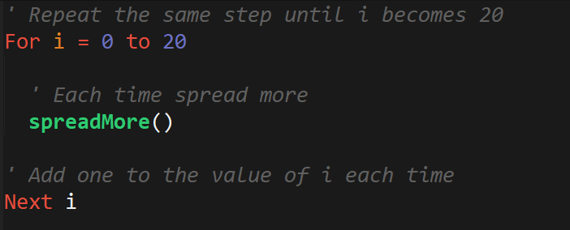
Iteration: Round and Round We Go!
This code will make more sense later… but basically it’s the VBA way of repeating the same block multiple times.
2

Slide 22
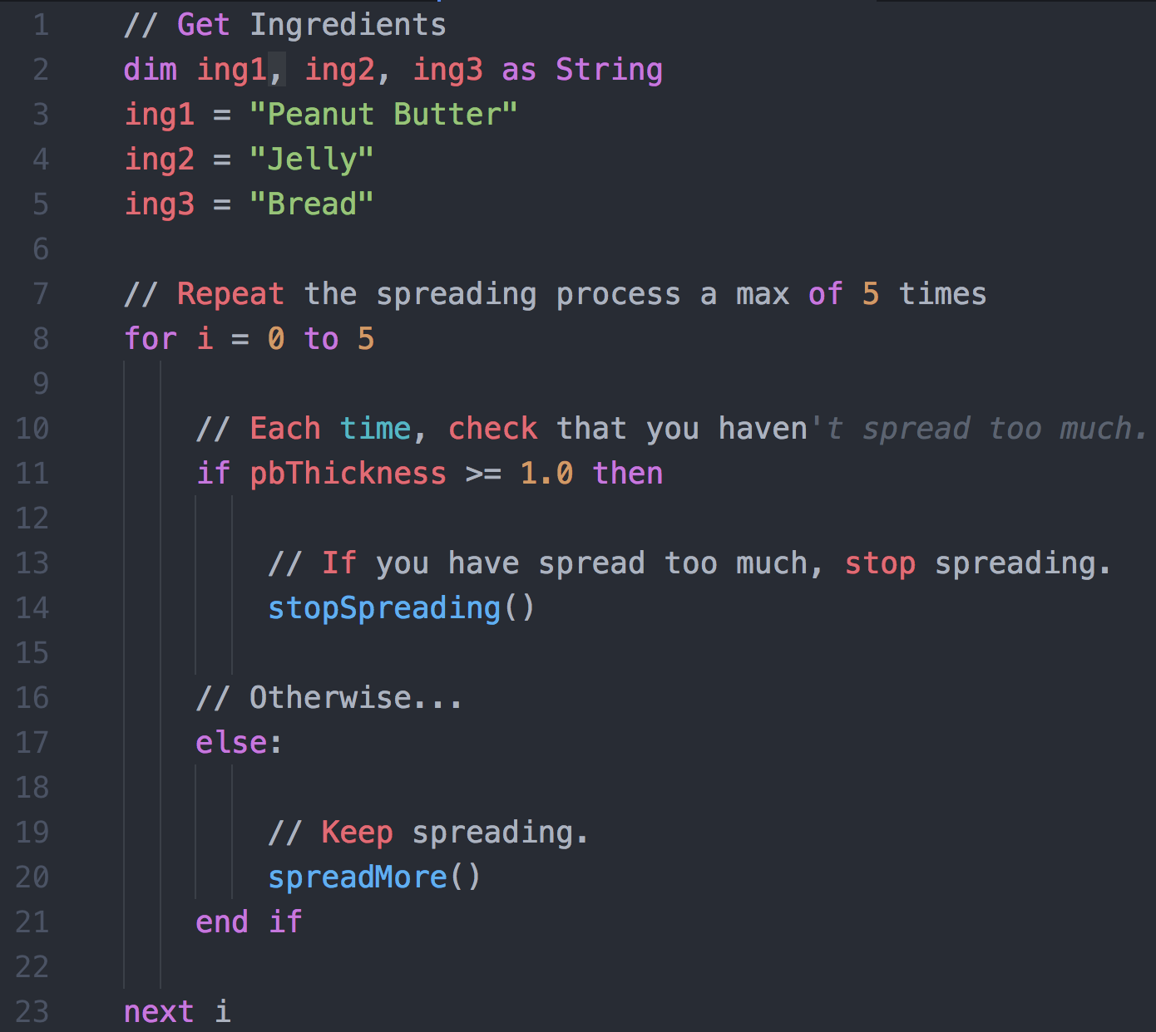
Build the Program!
Steps
1
2
3a
3b
Note: the loop above will actually iterates 6 times based on the statement on line #8

Slide 23
Functions

Slide 24
Functions: For When One Block Can’t Do it All
Functions are, in essence, a sort of “sub-processes”. They allow us to create pre-made, re-usable blocks of code which can be called on demand.
Main Process
1
2
3
4
1
2
3
1
2
3
3
Sub-Processes

Slide 25
Putting It All Together…

Slide 26
To Make a Sandwich…
Logical Procedure
1. Get Bread, Peanut Butter, and Jelly from Pantry
2. Lay out bread on table.
3. Open canisters of Peanut Butter and Jelly.
Oh! I can’t wait to be eaten!
4. Get spreading knife.
5. Use spreading knife to smother peanut butter.
6. Use spreading knife to smother jelly.
7. Combine bread to create sandwich.

Slide 27
To Make a Sandwich…
Logical Procedure
1. Get Bread, Peanut Butter, and Jelly from Pantry
2. Lay out bread on table.
3. Open canisters of Peanut Butter and Jelly.
Oh! I can’t wait to be eaten!
4. Get spreading knife.
5. Use spreading knife to smother peanut butter.
6. Use spreading knife to smother jelly.
7. Combine bread to create sandwich.

Slide 28
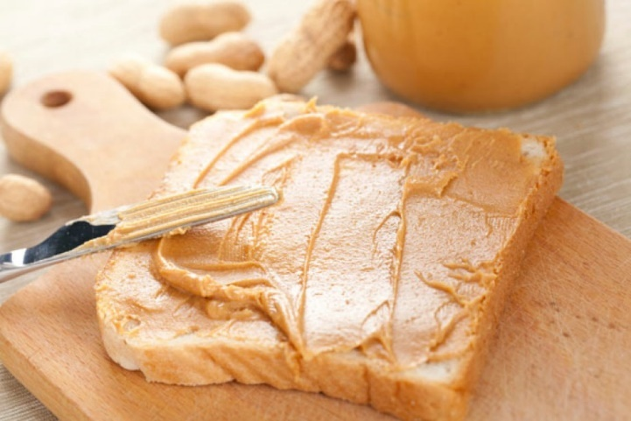
To Make a Sandwich (Full Logic)…
Get Items
Repeatedly “spread the Peanut Butter”
Check if thickness condition met.
3a. If thickness condition is met run stop function.
3b. If thickness condition is not met then spread more.
Steps
1
2
1
3a
3b
1
2
2

Slide 29
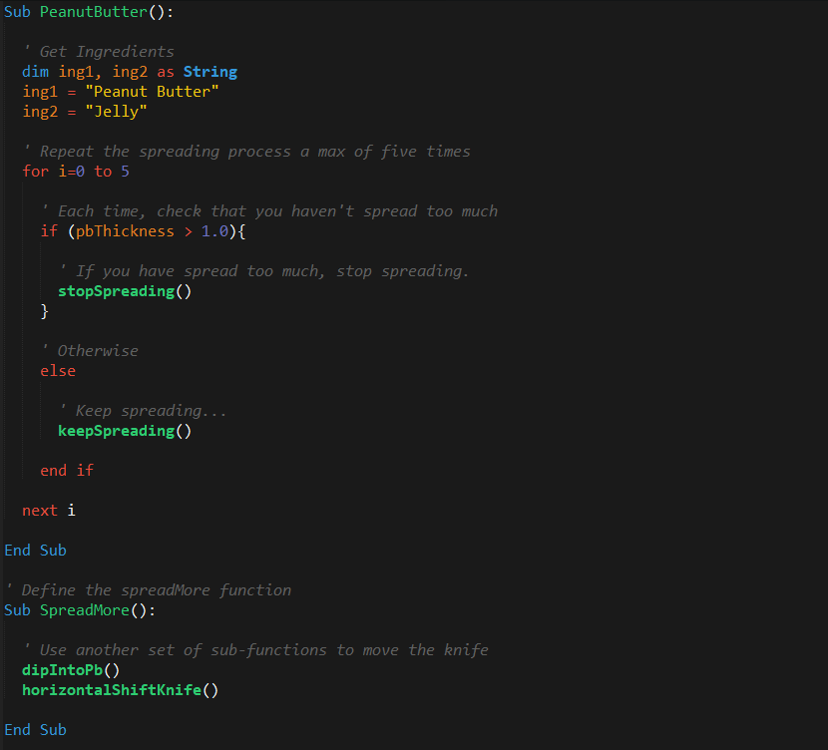
To Make a Sandwich (In Code)…
Steps
1
2
1
3a
3b
1
2
2

Slide 30

Big Picture!
Coding = Building Blocks and Putting them Together

Slide 31
Week 2 At-a-Glance
Understand:
The fundamental building blocks of all programming languages:
Variables/Arrays
Conditionals
Loops
Functions
The basic syntax of a VBA For loop
Utilize for-loops in conjunction with conditionals to direct flow
How to loop through a table using VBA code and check for changes in values
Begin to develop essential coding skills
Syntax recollection
Pattern recognition
Problem decomposition
Debugging
Excel VBA Programming: http://www.homeandlearn.org/excel_vba_practice1.html

Slide 32
Let’s Get Coding!

Slide 33
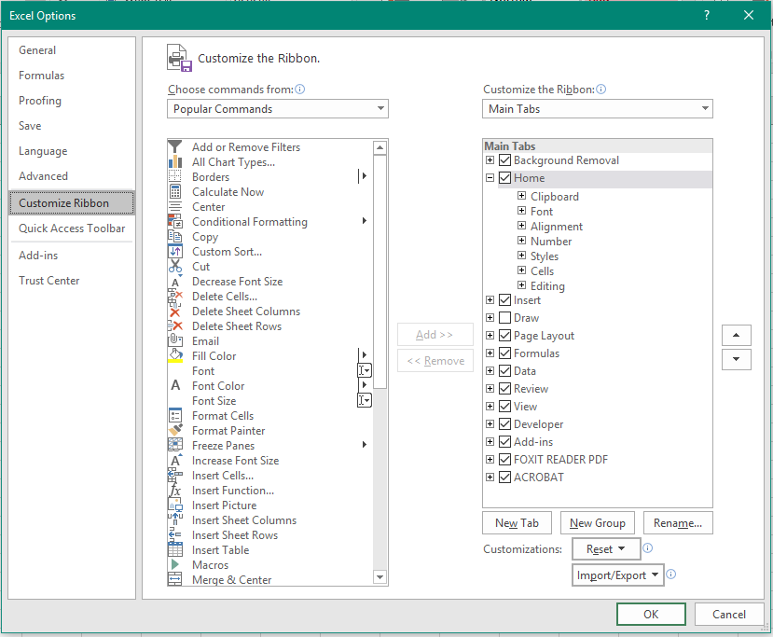
But First… Let’s Add Developer Tools!
On a Windows machine, visit File -> Excel Options.
Then navigate to Customize Ribbon to enable the Developer tab.

Slide 34
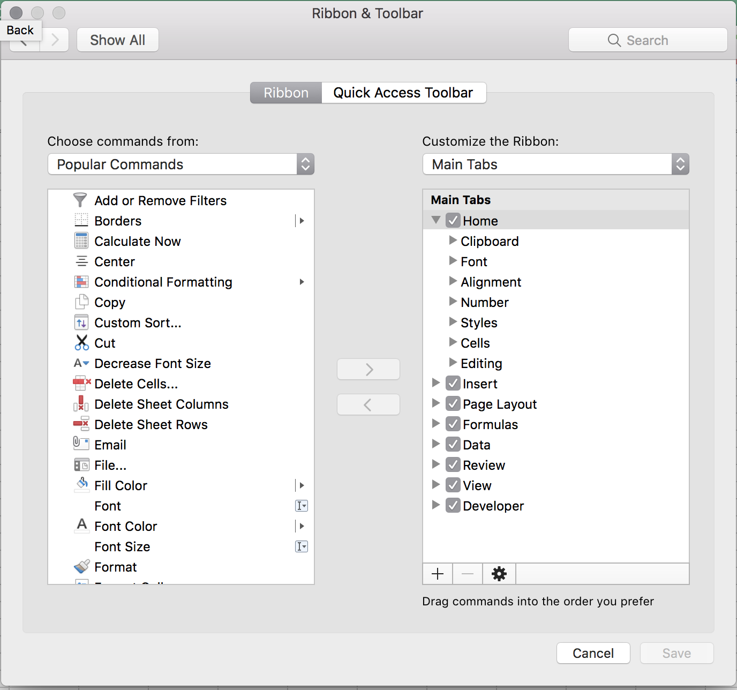
But First… Let’s Add Developer Tools!
On a Mac machine, visit Excel -> Preferences.
Then navigate to Ribbon and Toolbar to enable the Developer tab.

Slide 35
Button & Popup Alert

Slide 36
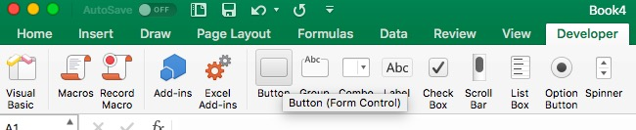
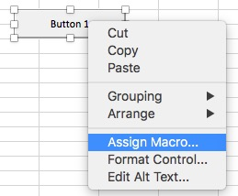
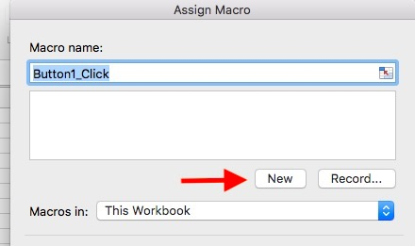
Button Click - Mac

Slide 37
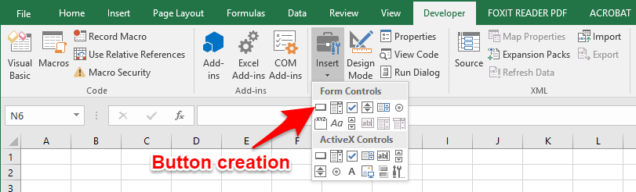
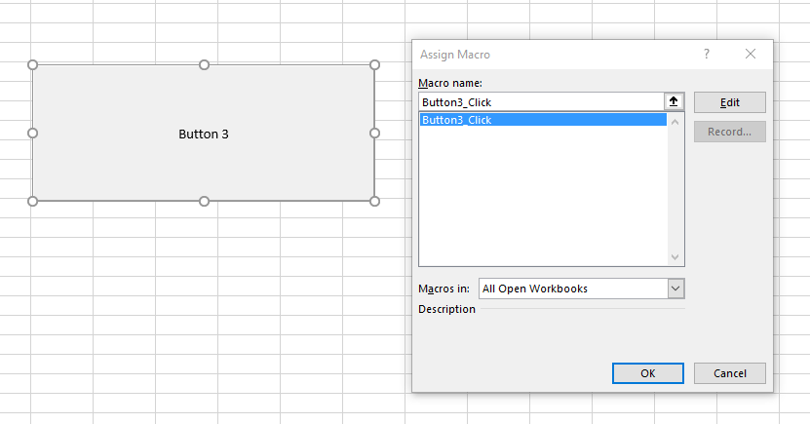
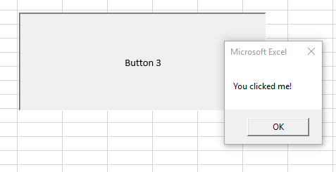
Button Click (HP)

Slide 38
Modify the contents of spreadsheet

Slide 39
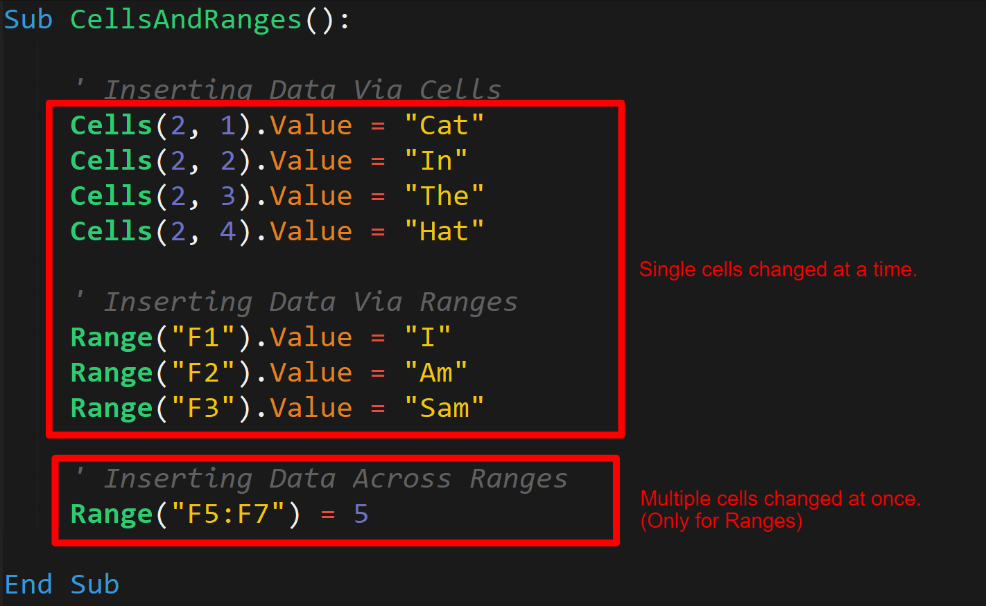
Ranges, Columns, Rows, Value
Cells(rowIndex, columnIndex)

Slide 40
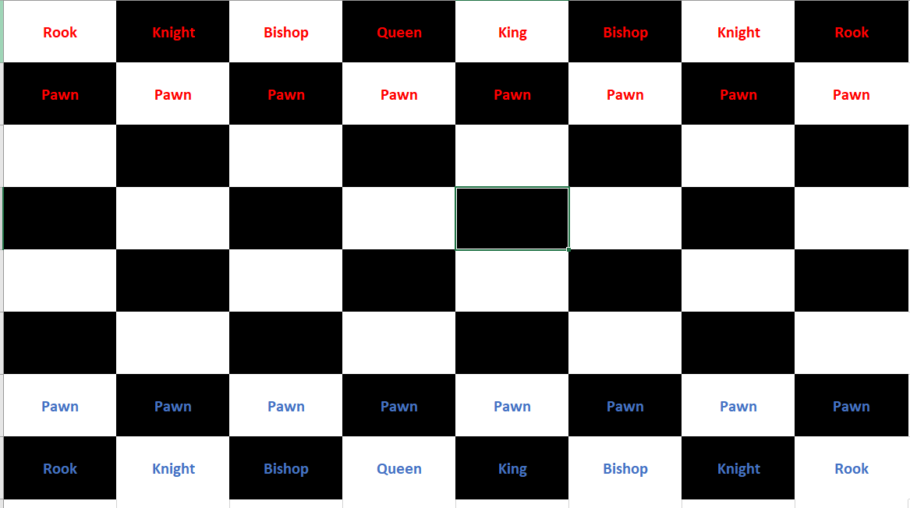
Group Activity – Chess Board!

Slide 41
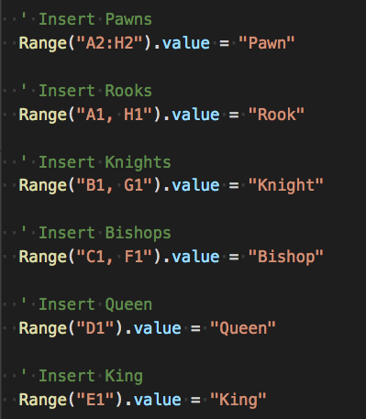
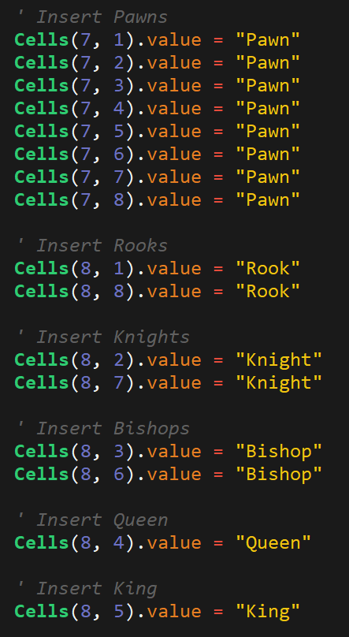
Chess Board Solution

Slide 42
Variables

Slide 43
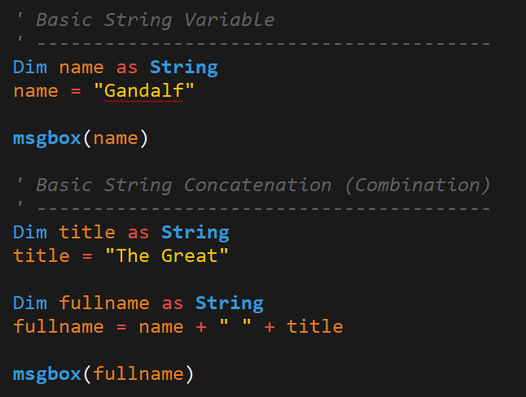
Refresher
Variables are named items in programming
They can store:
Texts (Strings)
Numerics:
Integers
Doubles for decimals
Booleans (true/false)
More…
Type Casting:
Int(variable)
Str(variable)

Slide 44
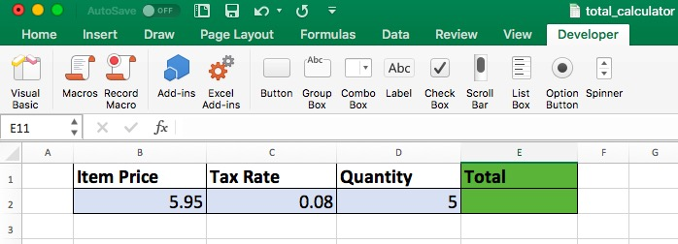
Group Activity - Calculator

Slide 45
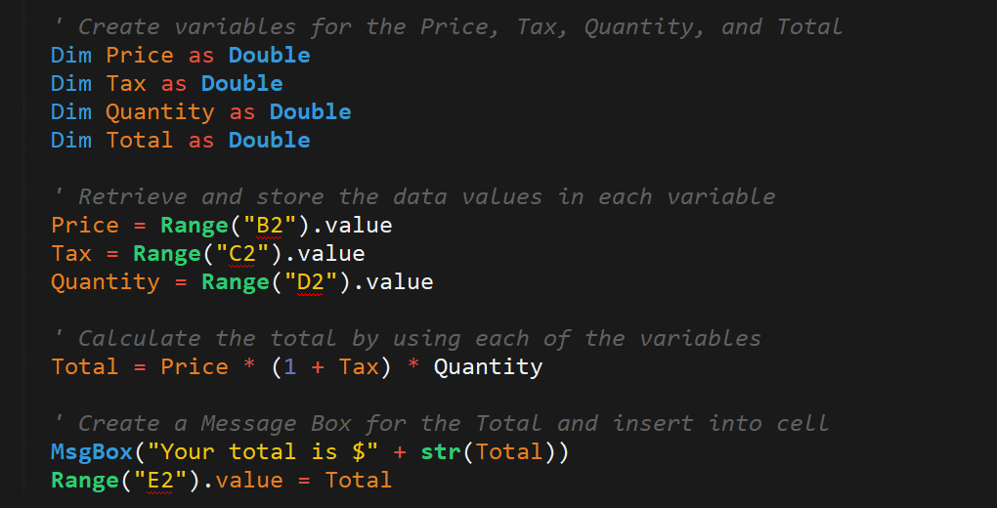
Solution - Calculator

Slide 46
Arrays

Slide 47
Adding / Retrieving Value
Arrays use zero-based numbering (0-indexed)
Base = lower bound
Total number of items = upper-bound + 1 = size
Meaning that the first element is 0
Zero-based numbering is a common paradigm across programming languages:
Python
Java
JavaScript
etc.
Adding / Retrieving value using the index
Array(index) = value
Variable = Array(index)

Slide 48
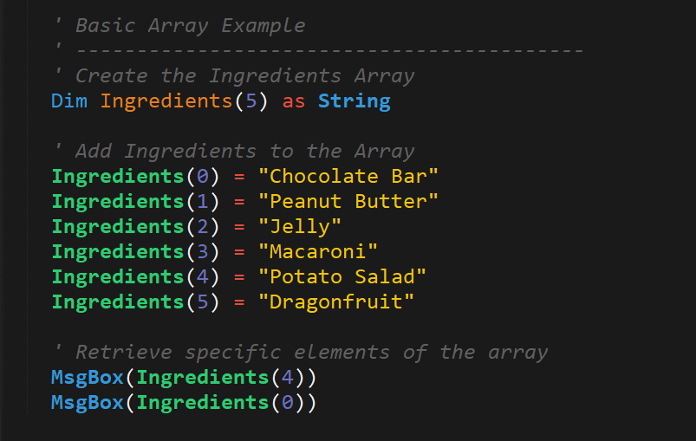
Example

Slide 49
String Splitting

Slide 50
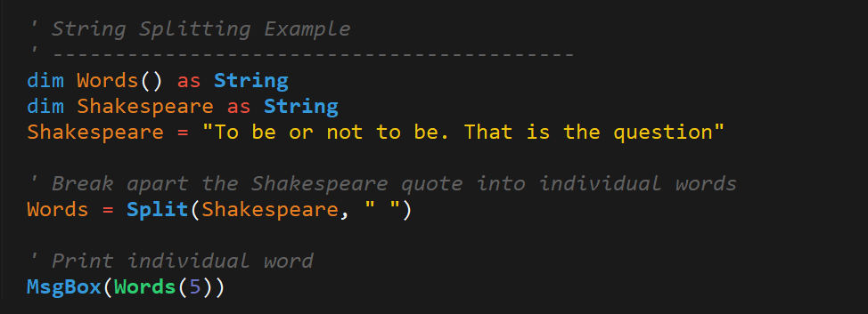
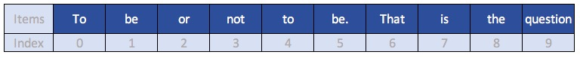
Example

Slide 51
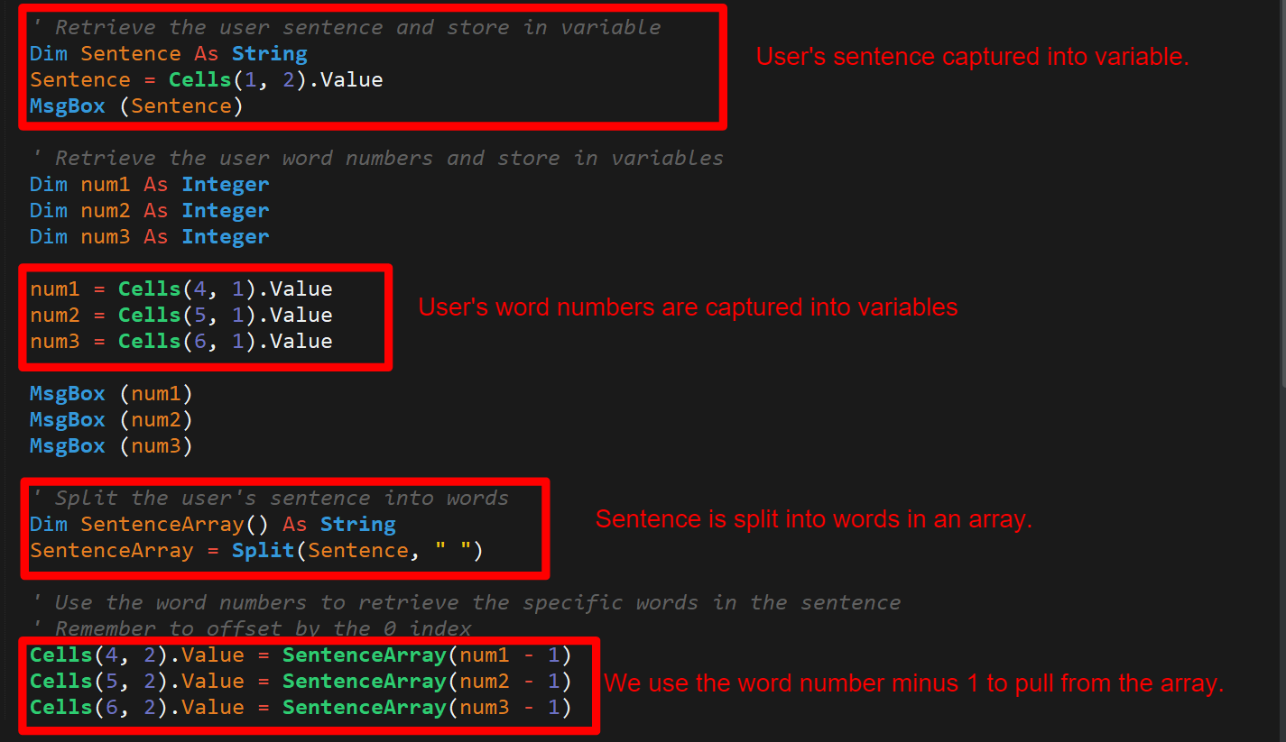
Class Activity - Sentence Breaker

Slide 52
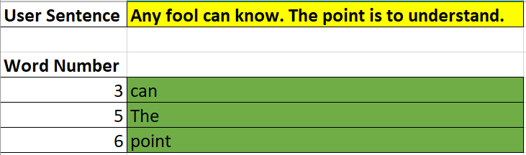
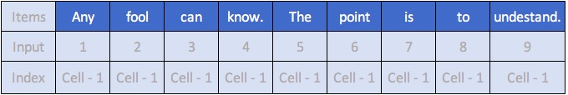
Class Activity - Sentence Breaker Cont’d
Hints:
Capture the numbers user entered
Split the sentence and store in an array
Use the values captured in step 1 to find and display the words

Slide 53
Conditionals
A real benefit over traditional Excel formulas

Slide 54
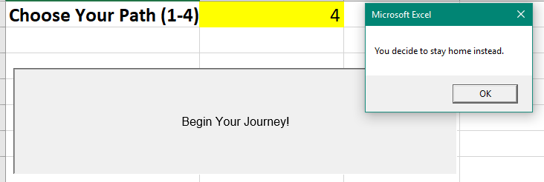
Group Activity - Begin Your Journey

Slide 55
Homework Assignment
Creating a VBA script to loop through stock market records to identify various stocks based on provided conditions.
…/DataViz-Lesson-Plans/02-Homework/02-VBA-Scripting/Instructions/README.md.
TA’s will Slack out to Slack Channel… ?

Slide 56
Helpful Links
https://docs.microsoft.com/en-us/dotnet/visual-basic/programming-guide/language-features/strings/zero-based-vs-one-based-string-access
https://superuser.com/questions/988321/which-excel-objects-are-zero-based-and-which-are-one-based
https://msdn.microsoft.com/en-us/library/microsoft.office.interop.excel.range_members(VS.80).aspx
https://www.excel-easy.com/vba/examples/size-of-an-array.html

